Slide 1
Chapter 11: Storage and File Structure
Rev. Aug 1, 2008

Slide 2
Classification of Physical Storage Media
Speed with which data can be accessed
Cost per unit of data
Reliability
  data loss on power failure or system crash
  physical failure of the storage device
Can differentiate storage into:
  volatile storage: loses contents when power is switched off
  non-volatile storage:
    Contents persist even when power is switched off.
    Includes secondary and tertiary storage, as well as battery-backed up main-memory.

Slide 3
Physical Storage Media
Cache – fastest and most costly form of storage; volatile; managed by the computer system hardware
  (Note: “Cache” is pronounced as “cash”)
Main memory:
  fast access (10s to 100s of nanoseconds; 1 nanosecond = 10^{–9} seconds)
  generally too small (or too expensive) to store the entire database
    capacities of up to a few Gigabytes widely used currently
    Capacities have gone up and per-byte costs have decreased steadily and rapidly (roughly factor of 2 every 2 to 3 years)
  Volatile — contents of main memory are usually lost if a power failure or system crash occurs.

Slide 4
Physical Storage Media (Cont.)
Flash memory
  Data survives power failure
  Data can be written at a location only once, but location can be erased and written to again
    Can support only a limited number (10K – 1M) of write/erase cycles.
    Erasing of memory has to be done to an entire bank of memory
  Reads are roughly as fast as main memory
  But writes are slow (few microseconds), erase is slower

Slide 5
Physical Storage Media (Cont.)
Flash memory
  NOR Flash
    Fast reads, very slow erase, lower capacity
    Used to store program code in many embedded devices
  NAND Flash
    Page-at-a-time read/write, multi-page erase
    High capacity (several GB)
    Widely used as data storage mechanism in portable devices

Slide 6
Physical Storage Media (Cont.)
Magnetic-disk
  Data is stored on spinning disk, and read/written magnetically
  Primary medium for the long-term storage of data; typically stores entire database.
  Data must be moved from disk to main memory for access, and written back for storage
  direct-access – possible to read data on disk in any order, unlike magnetic tape
  Survives power failures and system crashes
    disk failure can destroy data: is rare but does happen

Slide 7
Physical Storage Media (Cont.)
Optical storage
  non-volatile, data is read optically from a spinning disk using a laser
  CD-ROM (640 MB) and DVD (4.7 to 17 GB) most popular forms
  Write-one, read-many (WORM) optical disks used for archival storage (CD-R, DVD-R, DVD+R)
  Multiple write versions also available (CD-RW, DVD-RW, DVD+RW, and DVD-RAM)
  Reads and writes are slower than with magnetic disk
  Juke-box systems, with large numbers of removable disks, a few drives, and a mechanism for automatic loading/unloading of disks available for storing large volumes of data

Slide 8
Physical Storage Media (Cont.)
Tape storage
  non-volatile, used primarily for backup (to recover from disk failure), and for archival data
  sequential-access – much slower than disk
  very high capacity (40 to 300 GB tapes available)
  tape can be removed from drive ⇒ storage costs much cheaper than disk, but drives are expensive
  Tape jukeboxes available for storing massive amounts of data
    hundreds of terabytes (1 terabyte = 10⁹ bytes) to even a petabyte (1 petabyte = 10¹² bytes)

Slide 9
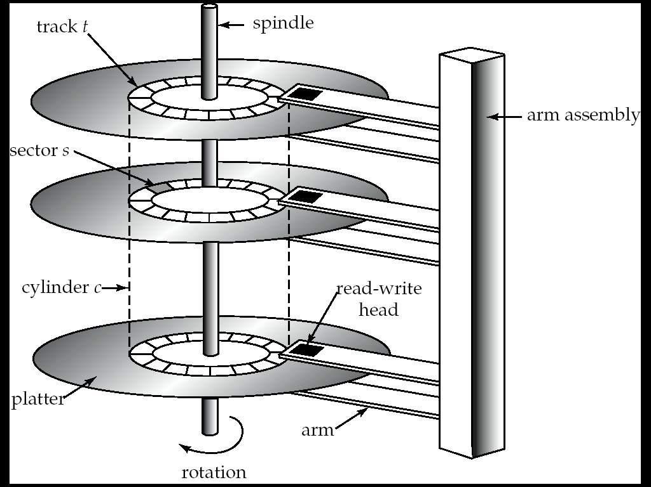
Magnetic Hard Disk Mechanism
NOTE: Diagram is schematic, and simplifies the structure of actual disk drives

Slide 10
Magnetic Disks
Read-write head
  Positioned very close to the platter surface (almost touching it)
  Reads or writes magnetically encoded information.
Surface of platter divided into circular tracks
  Over 50K-100K tracks per platter on typical hard disks
Each track is divided into sectors.
  Sector size typically 512 bytes
  Typical sectors per track: 500 (on inner tracks) to 1000 (on outer tracks)
To read/write a sector
  disk arm swings to position head on right track
  platter spins continually; data is read/written as sector passes under head

Slide 11
Magnetic Disks (Cont.)
Head-disk assemblies
  multiple disk platters on a single spindle (1 to 5 usually)
  one head per platter, mounted on a common arm.
Cylinder i consists of i^{th} track of all the platters
Earlier generation disks were susceptible to “head-crashes” leading to loss of all data on disk
  Current generation disks are less susceptible to such disastrous failures, but individual sectors may get corrupted

Slide 12
Disk Controller
Disk controller – interfaces between the computer system and the disk drive hardware.
  accepts high-level commands to read or write a sector
  initiates actions such as moving the disk arm to the right track and actually reading or writing the data
  Computes and attaches checksums to each sector to verify that data is read back correctly
    If data is corrupted, with very high probability stored checksum won’t match recomputed checksum
  Ensures successful writing by reading back sector after writing it
  Performs remapping of bad sectors

Slide 13
Performance Measures of Disks
Access time – the time it takes from when a read or write request is issued to when data transfer begins. Consists of:
  Seek time – time it takes to reposition the arm over the correct track.
    Average seek time is 1/2 the worst case seek time.
      Would be 1/3 if all tracks had the same number of sectors, and we ignore the time to start and stop arm movement
    4 to 10 milliseconds on typical disks
  Rotational latency – time it takes for the sector to be accessed to appear under the head.
    Average latency is 1/2 of the worst case latency.
    4 to 11 milliseconds on typical disks (5400 to 15000 r.p.m.)

Slide 14
Performance Measures (Cont.)
Data-transfer rate – the rate at which data can be retrieved from or stored to the disk.
  25 to 100 MB per second max rate, lower for inner tracks
  Multiple disks may share a controller, so rate that controller can handle is also important
    E.g. ATA-5: 66 MB/sec, SATA: 150 MB/sec, Ultra 320 SCSI: 320 MB/s
    Fiber Channel (FC2Gb): 256 MB/s

Slide 15
Performance Measures (Cont.)
Mean time to failure (MTTF) – the average time the disk is expected to run continuously without any failure.
  Typically 3 to 5 years
  Probability of failure of new disks is quite low, corresponding to a theoretical MTTF of 500,000 to 1,200,000 hours for a new disk
    E.g., an MTTF of 1,200,000 hours for a new disk means that given 1000 relatively new disks, on an average one will fail every 1200 hours
  MTTF decreases as disk ages

Slide 16
Optimization of Disk-Block Access
Block – a contiguous sequence of sectors from a single track
  data is transferred between disk and main memory in blocks
  Typical block sizes today range from 4 to 16 kilobytes
Disk-arm-scheduling algorithms order pending accesses to tracks so that disk arm movement is minimized
  elevator algorithm : move disk arm in one direction (from outer to inner tracks or vice versa), processing next request in that direction, till no more requests in that direction, then reverse direction and repeat

Slide 17
Optimization of Disk Block Access (Cont.)
File organization – optimize block access time by organizing the blocks to correspond to how data will be accessed
  E.g. Store related information on the same or nearby blocks/cylinders.
    File systems attempt to allocate contiguous chunks of blocks (e.g. 8 or 16 blocks) to a file
  Files may get fragmented over time
    E.g. if data is inserted to/deleted from the file
    Or free blocks on disk are scattered, and newly created file has its blocks scattered over the disk
    Sequential access to a fragmented file results in increased disk arm movement
  Some systems have utilities to defragment the file system, in order to speed up file access

Slide 18
Optimization of Disk Block Access (Cont.)
Nonvolatile write buffers speed up disk writes by writing blocks to a non-volatile RAM buffer immediately
  Non-volatile RAM: battery backed up RAM or flash memory
    Even if power fails, the data is safe and will be written to disk when power returns
  Controller then writes to disk whenever the disk has no other requests or request has been pending for some time
  Database operations that require data to be safely stored before continuing can continue without waiting for data to be written to disk
  Writes can be reordered to minimize disk arm movement

Slide 19
RAID
RAID: Redundant Arrays of Independent Disks
  disk organization techniques that manage a large numbers of disks, providing a view of a single disk of
    high capacity and high speed by using multiple disks in parallel, and
    high reliability by storing data redundantly, so that data can be recovered even if a disk fails
The chance that some disk out of a set of N disks will fail is much higher than the chance that a specific single disk will fail.
  E.g., a system with 100 disks, each with MTTF of 100,000 hours (approx. 11 years), will have a system MTTF of 1000 hours (approx. 41 days)

Slide 20
Improvement of Reliability via Redundancy
Redundancy – store extra information that can be used to rebuild information lost in a disk failure
E.g., Mirroring (or shadowing)
  Duplicate every disk. Logical disk consists of two physical disks.
  Every write is carried out on both disks
    Reads can take place from either disk
  If one disk in a pair fails, data still available in the other
    Data loss would occur only if a disk fails, and its mirror disk also fails before the system is repaired
      Probability of combined event is very small
        Except for dependent failure modes such as fire or building collapse or electrical power surges

Slide 21
Improvement of Reliability via Redundancy
Mean time to data loss depends on mean time to failure,
and mean time to repair
  E.g. MTTF of 100,000 hours, mean time to repair of 10 hours gives mean time to data loss of 500*10⁶ hours (or 57,000 years) for a mirrored pair of disks (ignoring dependent failure modes)

Slide 22
Improvement in Performance via Parallelism
Two main goals of parallelism in a disk system:
  1. Load balance multiple small accesses to increase throughput
  2. Parallelize large accesses to reduce response time.
Improve transfer rate by striping data across multiple disks.
Bit-level striping – split the bits of each byte across multiple disks
  But seek/access time worse than for a single disk
    Bit level striping is not used much any more
Block-level striping – with n disks, block i of a file goes to disk (i mod n) + 1
  Requests for different blocks can run in parallel if the blocks reside on different disks
  A request for a long sequence of blocks can utilize all disks in parallel

Slide 23

RAID Levels
RAID organizations, or RAID levels, have differing cost, performance and reliability characteristics
RAID Level 0: Block striping; non-redundant.
  Used in high-performance applications where data lost is not critical.
RAID Level 1: Mirrored disks with block striping
  Offers best write performance.
  Popular for applications such as storing log files in a database system.

Slide 24
RAID Levels (Cont.)
RAID Level 2: Memory-Style Error-Correcting-Codes (ECC) with bit striping.
RAID Level 3: Bit-Interleaved Parity
  a single parity bit is enough for error correction, not just detection
    When writing data, corresponding parity bits must also be computed and written to a parity bit disk
    To recover data in a damaged disk, compute XOR of bits from other disks (including parity bit disk)

Slide 25
RAID Levels (Cont.)
RAID Level 3 (Cont.)
  Faster data transfer than with a single disk, but fewer I/Os per second since every disk has to participate in every I/O.
RAID Level 4: Block-Interleaved Parity; uses block-level striping, and keeps a parity block on a separate disk for corresponding blocks from N other disks.
  When writing data block, corresponding block of parity bits must also be computed and written to parity disk
  To find value of a damaged block, compute XOR of bits from corresponding blocks (including parity block) from other disks.

Slide 26
RAID Levels (Cont.)
RAID Level 4 (Cont.)
  Provides higher I/O rates for independent block reads than Level 3
    block read goes to a single disk, so blocks stored on different disks can be read in parallel
  Before writing a block, parity data must be computed
    Can be done by using old parity block, old value of current block and new value of current block (2 block reads + 2 block writes)
    Or by recomputing the parity value using the new values of blocks corresponding to the parity block
      More efficient for writing large amounts of data sequentially
  Parity block becomes a bottleneck for independent block writes since every block write also writes to parity disk

Slide 27
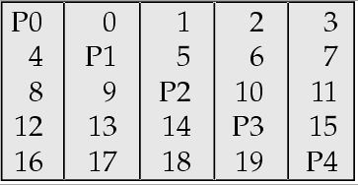
RAID Levels (Cont.)
RAID Level 5: Block-Interleaved Distributed Parity; partitions data and parity among all N + 1 disks, rather than storing data in N disks and parity in 1 disk.
  E.g., with 5 disks, parity block for nth set of blocks is stored on disk (n mod 5) + 1, with the data blocks stored on the other 4 disks.

Slide 28
RAID Levels (Cont.)
RAID Level 5 (Cont.)
  Higher I/O rates than Level 4.
    Block writes occur in parallel if the blocks and their parity blocks are on different disks.
  Subsumes Level 4: provides same benefits, but avoids bottleneck of parity disk.
RAID Level 6: P+Q Redundancy scheme; similar to Level 5, but stores extra redundant information to guard against multiple disk failures.
  Better reliability than Level 5 at a higher cost; not used as widely.

Slide 29
Choice of RAID Level
Factors in choosing RAID level
  Monetary cost
  Performance: Number of I/O operations per second, and bandwidth during normal operation
  Performance during failure
  Performance during rebuild of failed disk
    Including time taken to rebuild failed disk
RAID 0 is used only when data safety is not important
  E.g. data can be recovered quickly from other sources
Level 2 and 4 never used since they are subsumed by 3 and 5
Level 3 is not used since bit-striping forces single block reads to access all disks, wasting disk arm movement
Level 6 is rarely used since levels 1 and 5 offer adequate safety for most applications
So competition is mainly between 1 and 5

Slide 30
Choice of RAID Level (Cont.)
Level 1 provides much better write performance than level 5
  Level 5 requires at least 2 block reads and 2 block writes to write a single block, whereas Level 1 only requires 2 block writes
  Level 1 preferred for high update environments such as log disks
Level 1 had higher storage cost than level 5
  disk drive capacities increasing rapidly (50%/year) whereas disk access times have decreased much less (x 3 in 10 years)
  I/O requirements have increased greatly, e.g. for Web servers
  When enough disks have been bought to satisfy required rate of I/O, they often have spare storage capacity
    so there is often no extra monetary cost for Level 1!
Level 5 is preferred for applications with low update rate,
and large amounts of data
Level 1 is preferred for all other applications

